Slide 1
SOLARITY
SOLARITY
2021
The truly scalable cross
chain metaverse for DAOs
© 2021. All Rights Reserved

Slide 2
Vision
Solarity aims to significantly improve standards for these fields:
People
Metaverse
DAOs to let users rule
Land to let users own
Defi to let users play (for free)
DAOS
Open metaverse structure from the galaxy of interconnected DAOs
VR focus linked to crypto economic system to achieve Google Stadia quality
The green metaverse: energy saving chains
Legally compliant structure to give web2 guarantees to web3 builders
Flawless cross-DAOs interactions, with hierarchical DAOs & sub DAOs
Effortless continuous funding through land NFTs
DAO creation facilitator

Slide 3
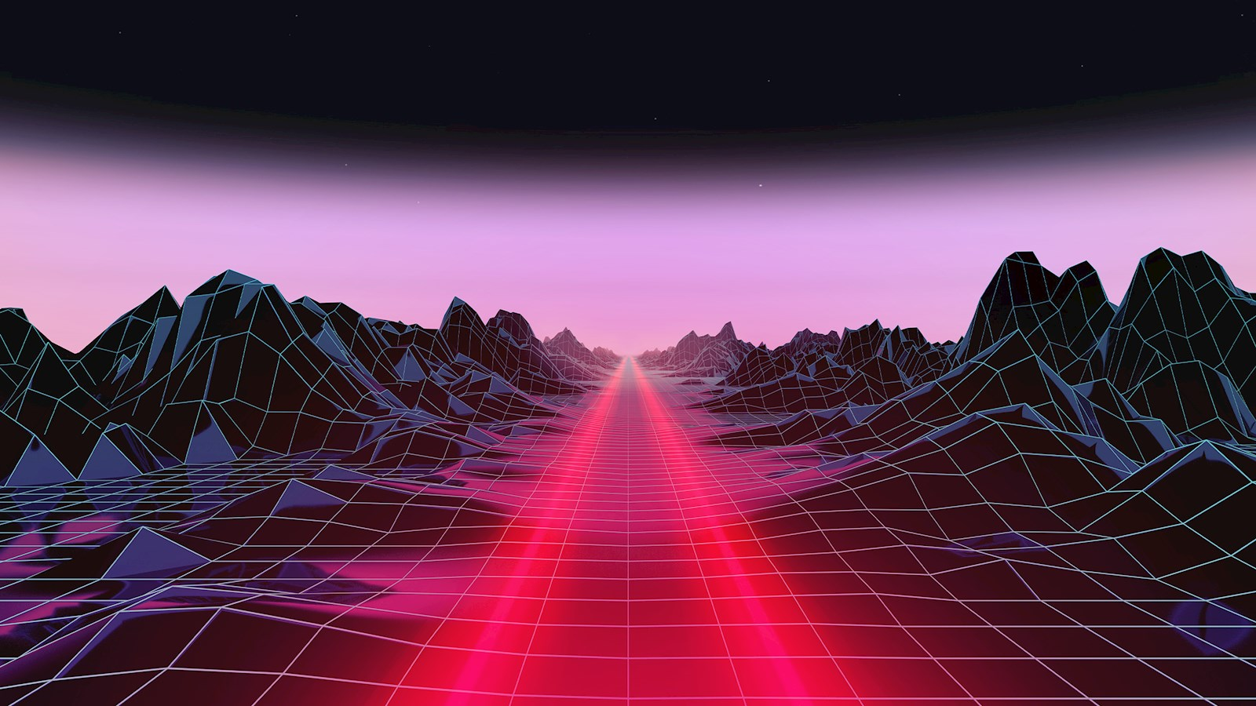


SOLARITY
Solarity as the metaverse provider
Interconnected DAOverses Galaxies with
multiple Decentraland, Sandbox etc.
VR studios
Gamefi/Defi/
Metaverse projects
Brands
Solarity
Cross-metaverse aggregator and provider
MetaDots
Cross-chain bridge of metaverses using a DAG system
Ⓒ SOLARITY 2021. All rights reserved
3

Slide 4
MetaDots
Infinite Outcomes
Common Structure using a DAG
Inter-Planetary Inter-Chain communications through MetaDots (Player transactions etc)
Feeless computation for in-game NFTs (ammunitions, potions etc)
Web2-like game experience in terms of latencies and costs
The DAG becomes the Data Availability layer for a server-less level of decentralization
Tools and SDKs creations for easy and flawless gaming creation
VR Planet
on Etherum
VR Planet
on NEAR
Solarity
on Solana
VR Planet
on BSC
VR Planet
on Fantom
MetaDots
DAG Common Data
Data about every “Planet”, not tied to Blockchains

Slide 5
SolVegas for profit DAO
Solarity DAPP example:
Solvegas, A decentralized
VR casino
World Engineers
a non profit DAO
VR Devs
a non profit DAO
Casino Employees
a non profit Dao
member
For profit Treasury
member
member
Automatic distribution inside Builders DAOs
Non profit builders Treasury
World Designers
a non profit DAO
member
member
Casino Employees
a non profit Dao
member
member
Users and advertisers bring revenue
to the SolVegas treasury,
member

Slide 6
Features
For Solarity’s Land Owners
Self-sustainable through an innovative Crypto-economic system
DeFi treasuries to scale VR Worlds
Solana for cheap and fast transactions and for a truly scalable metaverse
For the Open Metaverse Community
Daos As A Service, 2 Symmetrical Structures for Seamless Inter-DAOs Interaction
(For Profit DAOs & Non Profit DAOs)
Hyper-scalable and replicable
(2-Clicks DAO Deployment)
Each Metaverse with its own Metaverse Currency and Economic & Fiscal policies

Slide 7



Gaming
Virtual World (decentraland)
MMORPG (GTA)
P2E games / Launchpad for Indie Game Devs
Use
Cases
Creators
Community meeting point
Interactive NFT marketplace
Concerts and events
Next level DAO interactions
Businesses
Subscription model (Tinder, Netflix)
Membership model (Any DAOs, Clubs)
Enhance Web2 businesses through an immersive VR experience
Virtual World (decentraland)
MMORPG (GTA)
P2E games / Launchpad for Indie Game Devs
Community meeting point
Interactive NFT marketplace
Concerts and events
Next level interactions
Subscription model (Tinder, Netflix)
Membership model (Any DAOs, Clubs)

Slide 8
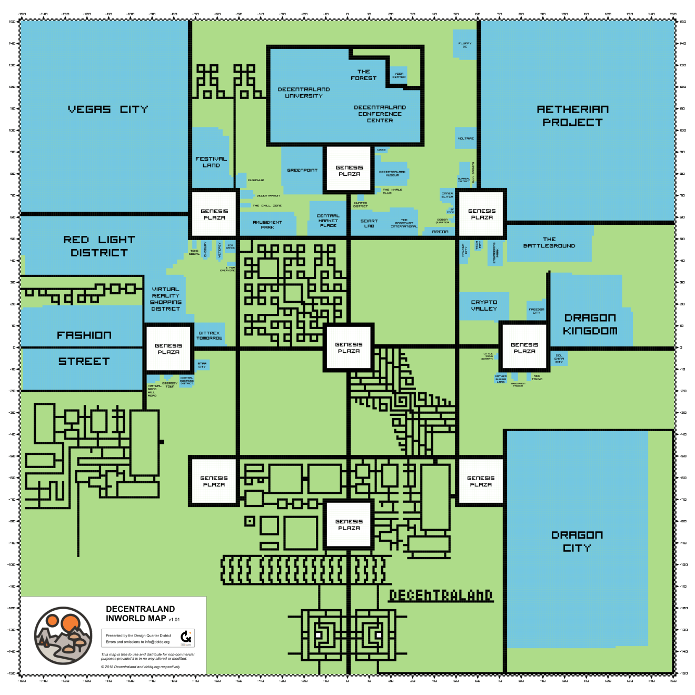
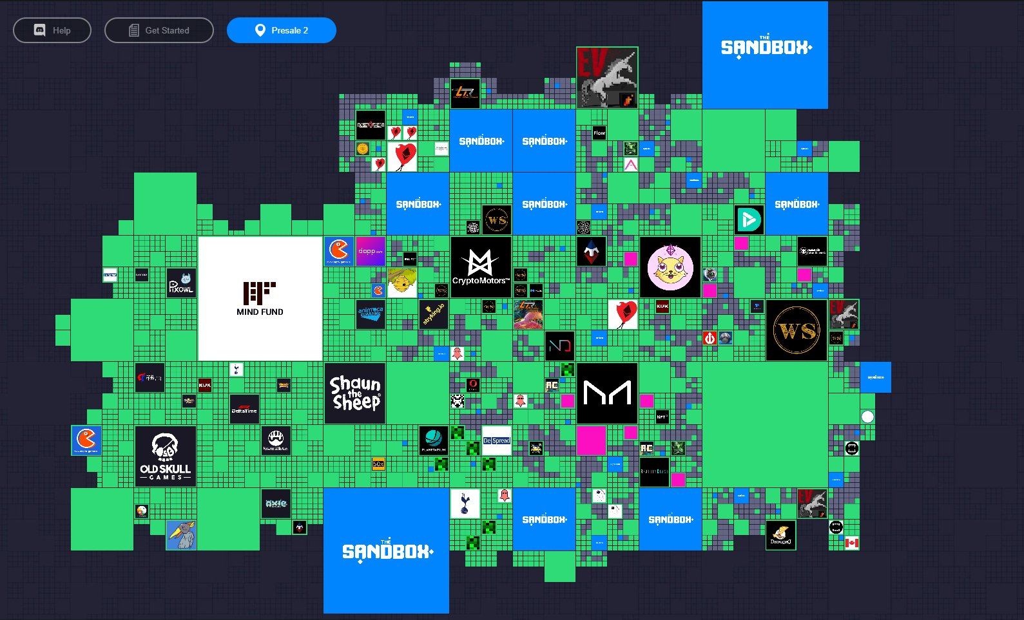
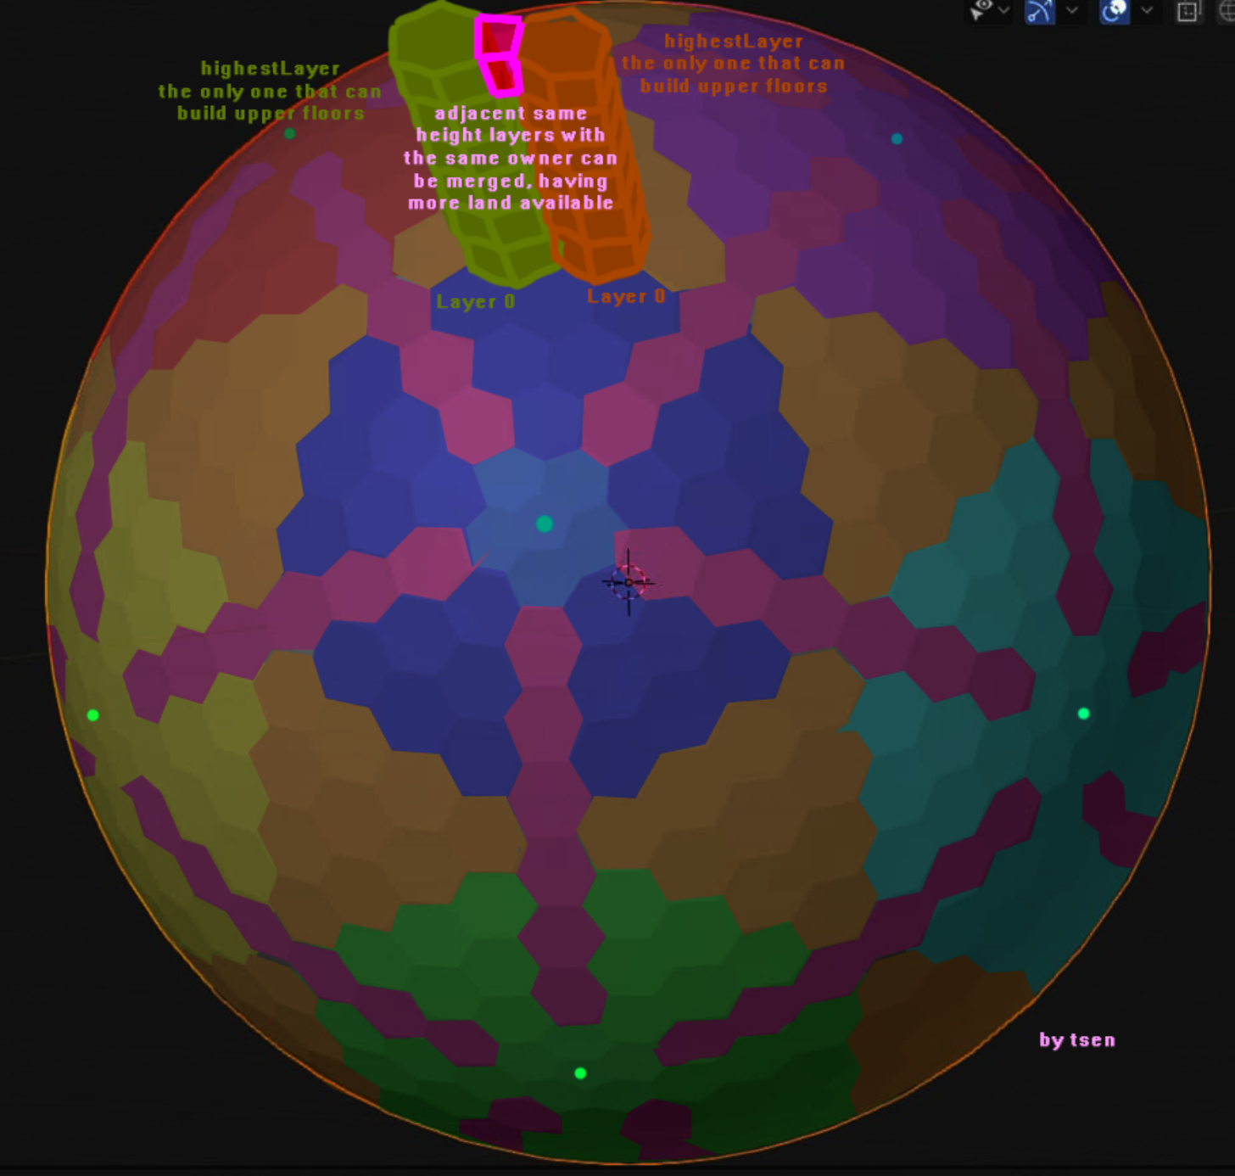
Landonomics Comparison
(Virtual Worlds Stats, Land ecc)
Decentraland (flat)
Sandbox (flat)
Solarity (spherical)
1 Tile
16m x 16m
96m x 96m
10m x 10m
Total Parcels
90601
166.646
1000, expandable up to 3’147’212
Total different owners
5.6k
15.6k
Land Upgrades
Not available
Not available
Available
Land Floor
3.7 ETH
0.78 ETH
0.01 SOL+
Market Cap
9,000,000,000 $
15,000,000,000 $

Slide 9

Tokenomics
Community token / Metaverse Currency
Gov. tokens
Land and NFTs
Govern:
Treasury
Crypto-economic system Parameters
Non-Transferable.
(burn $VERSE to get more)
Govern:
Solarity’s Protocol (metagovernance)
Your Land (Permissionless Platform)
Buy, sell, upgrade and govern your land (Buy with $VERSE)
Tokenomics & Economic Cycles
Inflationary Metaverse Currency = $VERSE
Early Staking Rewards (until MainNet)
Dynamic Polynomial Function for Land Upgrade Costs
6370 Economic Cycles each of 314M $VERSE

Slide 10



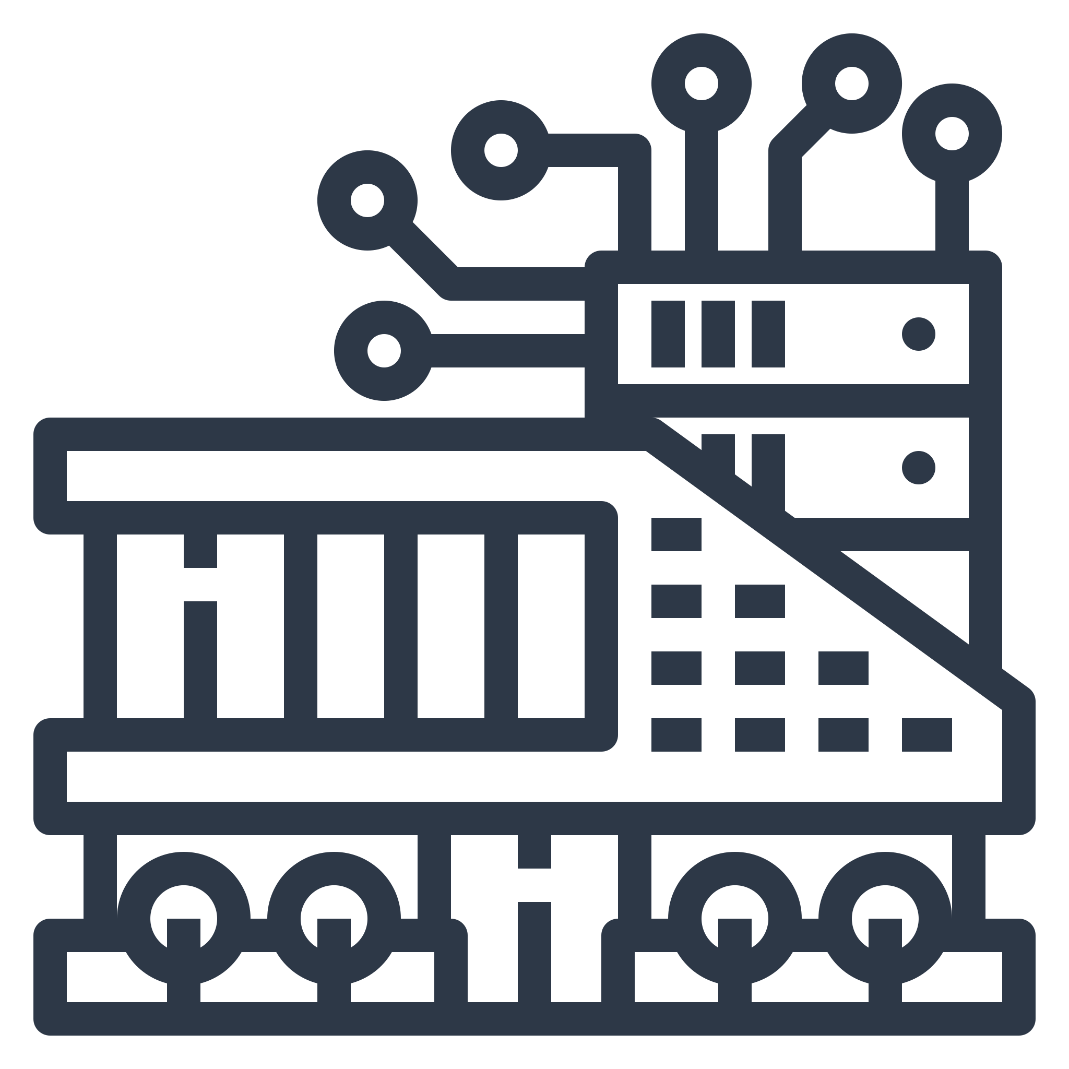
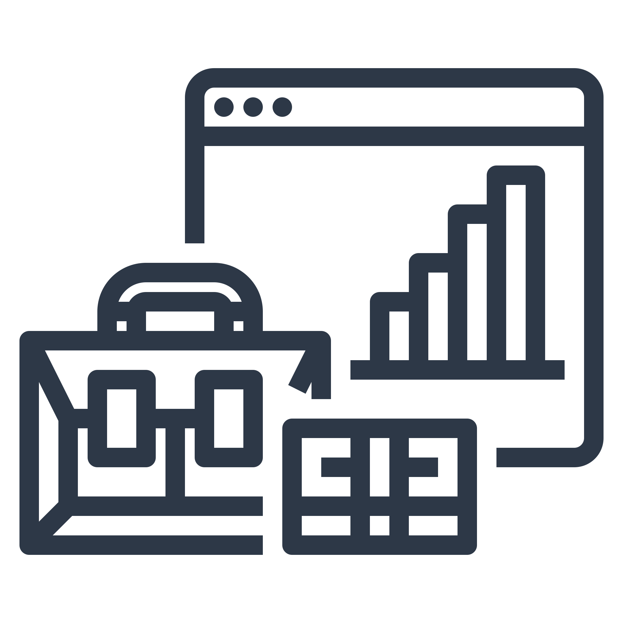

Roadmap
Solarity webXR App w/
UI/UX Goldberg DAOs
NFT VR rooms
Multiple DAPPs & template releases,
Metaverse launchpad
Cloud computed VR world for everybody
Q1 2022
Q2 2022
Q3 2022
Q4 2022
Q1 2023
Future
First Solarity planet release
Land auction
IDO launch
Governance token auction
Game engine release w/ NFTs on DAGs
Game and NFT maker inside Solarity
Self-Destruction of the DAO and fully democratization of the platform to maximize Net Neutrality

Slide 11
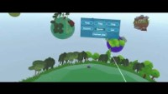
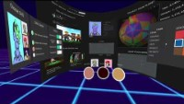
What we did so far:
Pre-Alpha game:
Alpha dashboard webXR app:

Slide 12
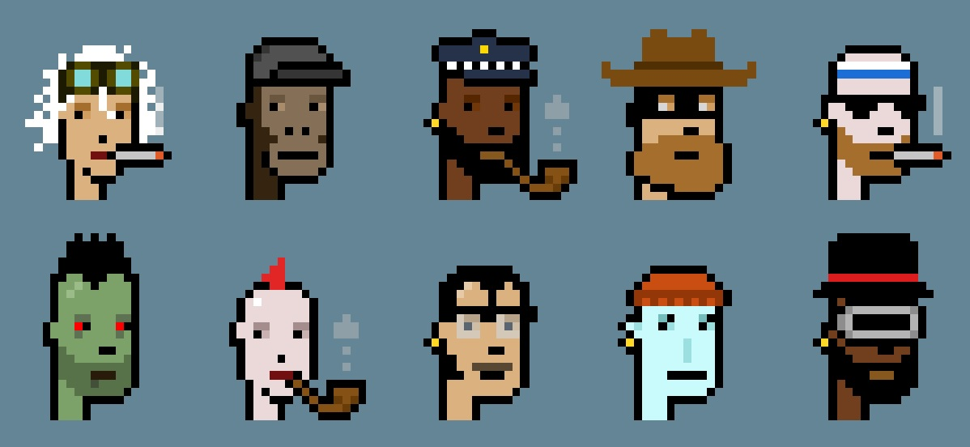
Meta
Rocco
Zekai
Game development lead,
Crypto economic system lead,
Principal engineer,
The
Team
Andrea
Nicolas
Vik
ca
UX lead,
Blockchain developer,
Blockchain developer,
UC Berkeley &
Milan Politecnico undergrads
Tommy
Paolo
Edo
Game developer,
Legal assistance,
Business development

